Slide 1


U.S. GLOBEC Symposium & Celebration
October 4-5, 2011
Jim Yoder, Member, Ocean Studies Board

Slide 2



The National Academy of Sciences
A private, non-profit organization charged to provide advice to the Nation on science, engineering, and medicine.
National Academy of Sciences (NAS) chartered in 1863; The National Research Council (NRC) is the operating arm of the NAS, NAE, and IOM.
NRC convenes ad hoc committees of experts who serve pro bono, and who are carefully chosen for expertise, balance, and objectivity
All reports go through stringent peer-review and must be approved by both the study committee and the institution.
Full text and PDF summaries of reports available for free at http://www.nap.edu/

Slide 3




The Ocean Studies Board
…explore the science, policies, and infrastructure needed to understand, manage, and conserve coastal and marine environments and resources.
Conducts studies or workshops on emerging scientific and policy issues;
Provides a forum to discuss issues at the interface of ocean science and policy;
Serves as US National Committee for SCOR and the US Committee for the IOC; and
Supports education and outreach activities through the Roger Revelle Commemorative Lecture, sponsorship of interns and fellows, and participation in the MSPHD’S program.

Slide 4
U.S. GLOBEC
Accomplishments & Legacy
Among many accomplishments, the GLOBEC program “Improved understanding of physical oceanographic phenomena on juvenile cod and haddock populations; and
Improved understanding of the persistence of transients in structured ecological models.” (In: Global Ocean Science, NRC 1999)
Such global programs leave a “legacy of high-quality, high-resolution, multiparameter data sets; new and improved facilities and techniques; and a large number of trained technicians and young scientists.” (NRC 1999)
“The discoveries, data, and facilities will continue to be used to increase the understanding of fundamental earth system processes well after the current generation of programs have ended.” (NRC 1999)

Slide 5
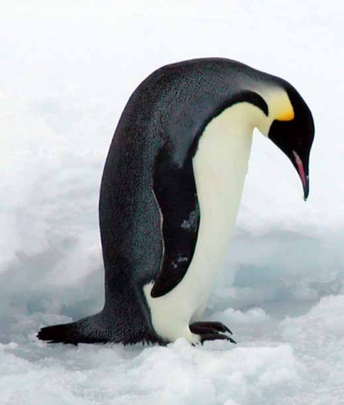
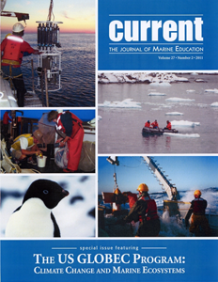
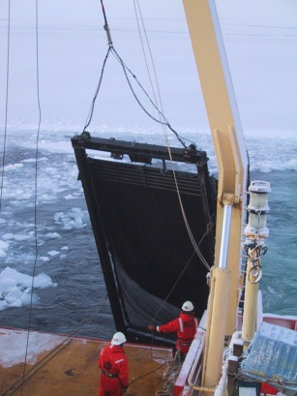
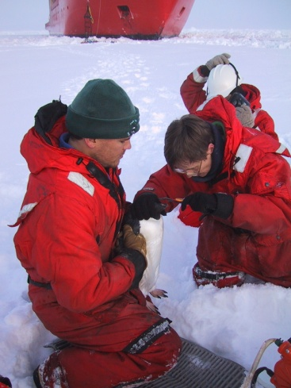
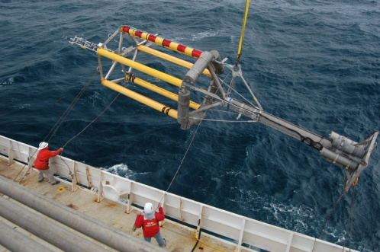
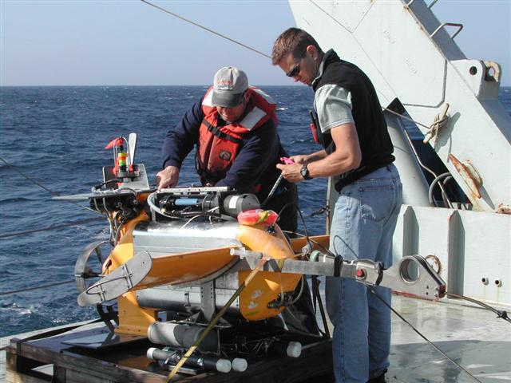
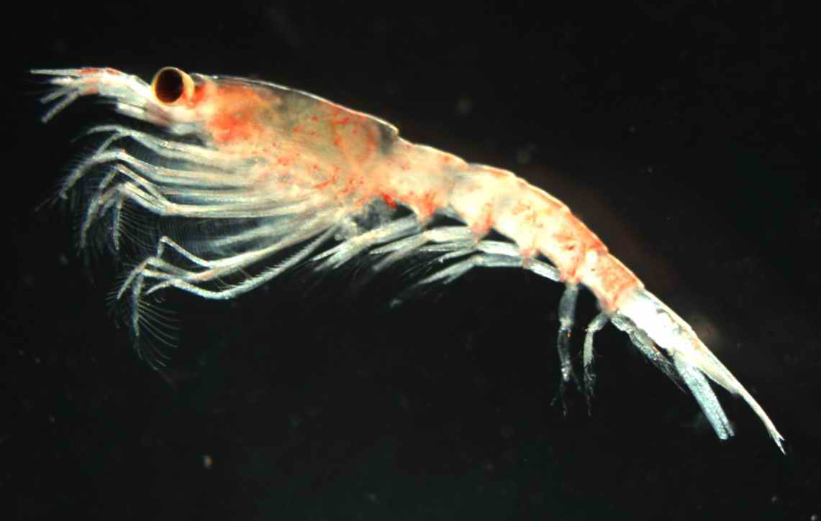
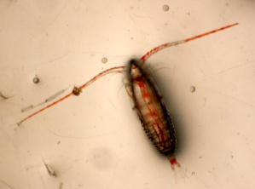
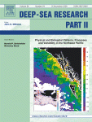
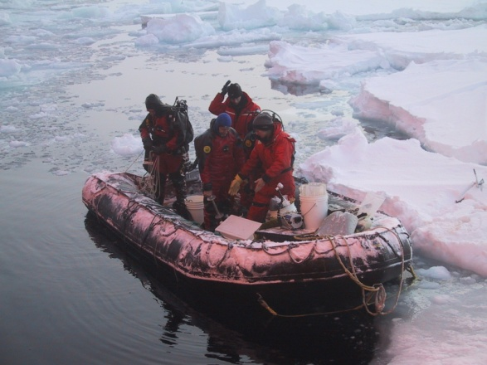
Welcome to the Celebration of
U.S. GLOBEC’s Accomplishments!

